Slide 1
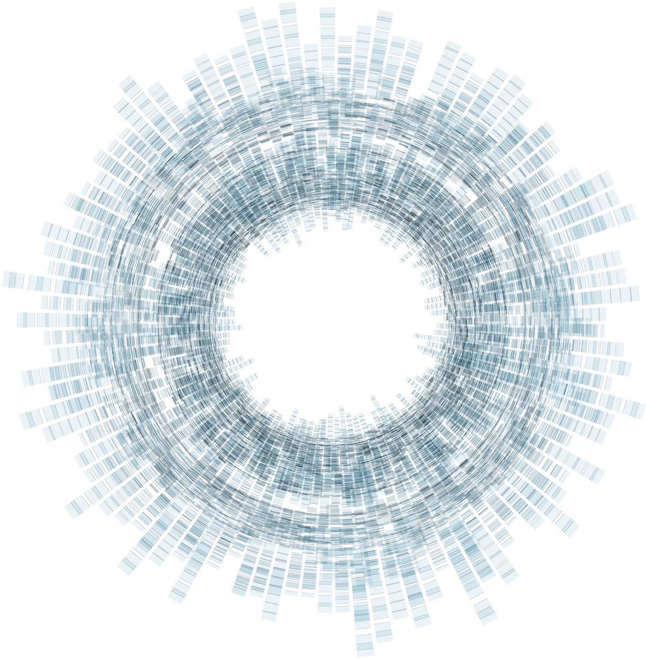

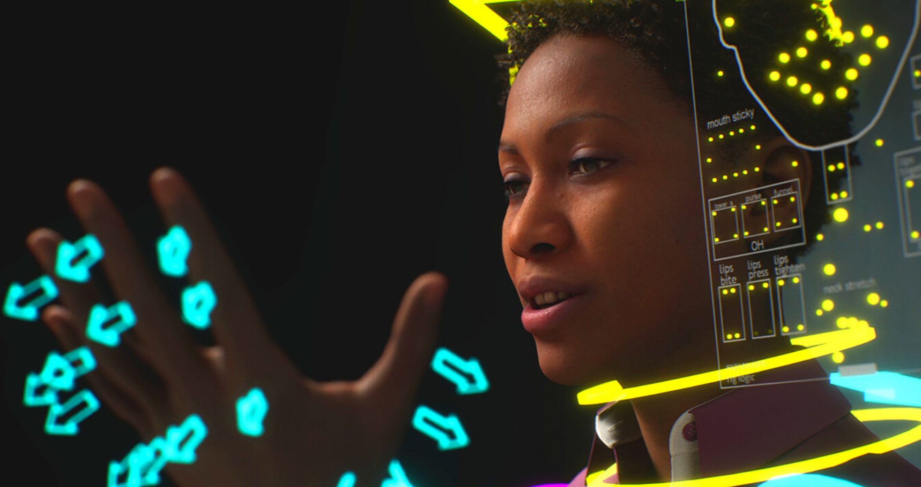
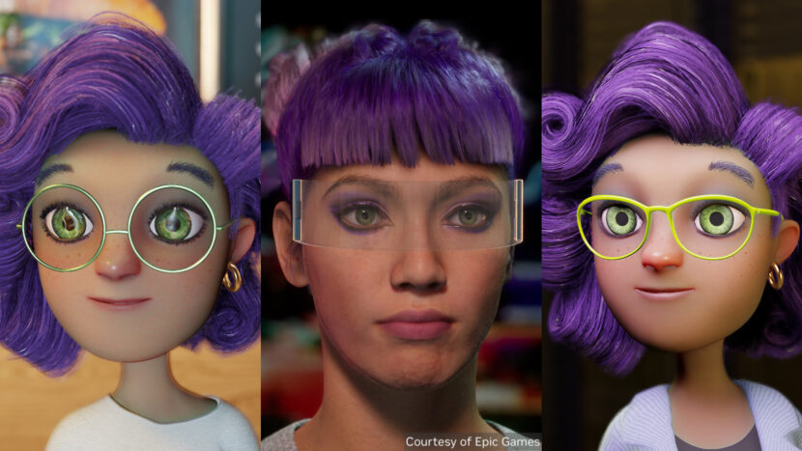
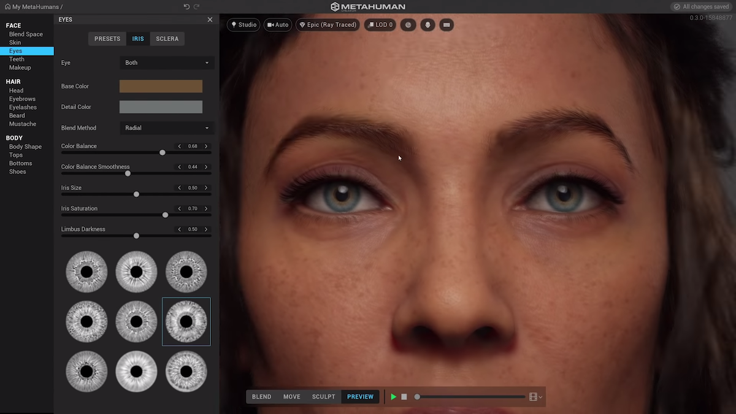

Digital Humans
“Coding
Digital Agents
vs
MetaHumans
Game Engines”
Les 03
hr.nl/ai

Slide 2

Animated “digital Humans”
Hoe bouw
en test je
zulke AI-technologie?

Slide 3
Taxonomie implementatie
technologie niveau’s voor
“digital Humans” bevat 3 lagen: Talig / Fysiek / Digitaal

Slide 4
Talig : Conversationele Agenten Fysiek: Robotica / Cybernetica / “Reinforced Learning”
Digitaal: AI-gedreven Video “Dubbing” & “Motion Capture”
Game Engines [ +Omniverse Connectors]
https://www.fxguide.com/quicktakes/nvidia-ace-enables-easier-interactive-avatars/
https://blogs.nvidia.com/blog/2023/04/21/epic-benefits-omniverse-connector-unreal-engine/

Slide 5
Coding & SDKs zijn een vereiste voor alle implemenatie niveau’s

Slide 6
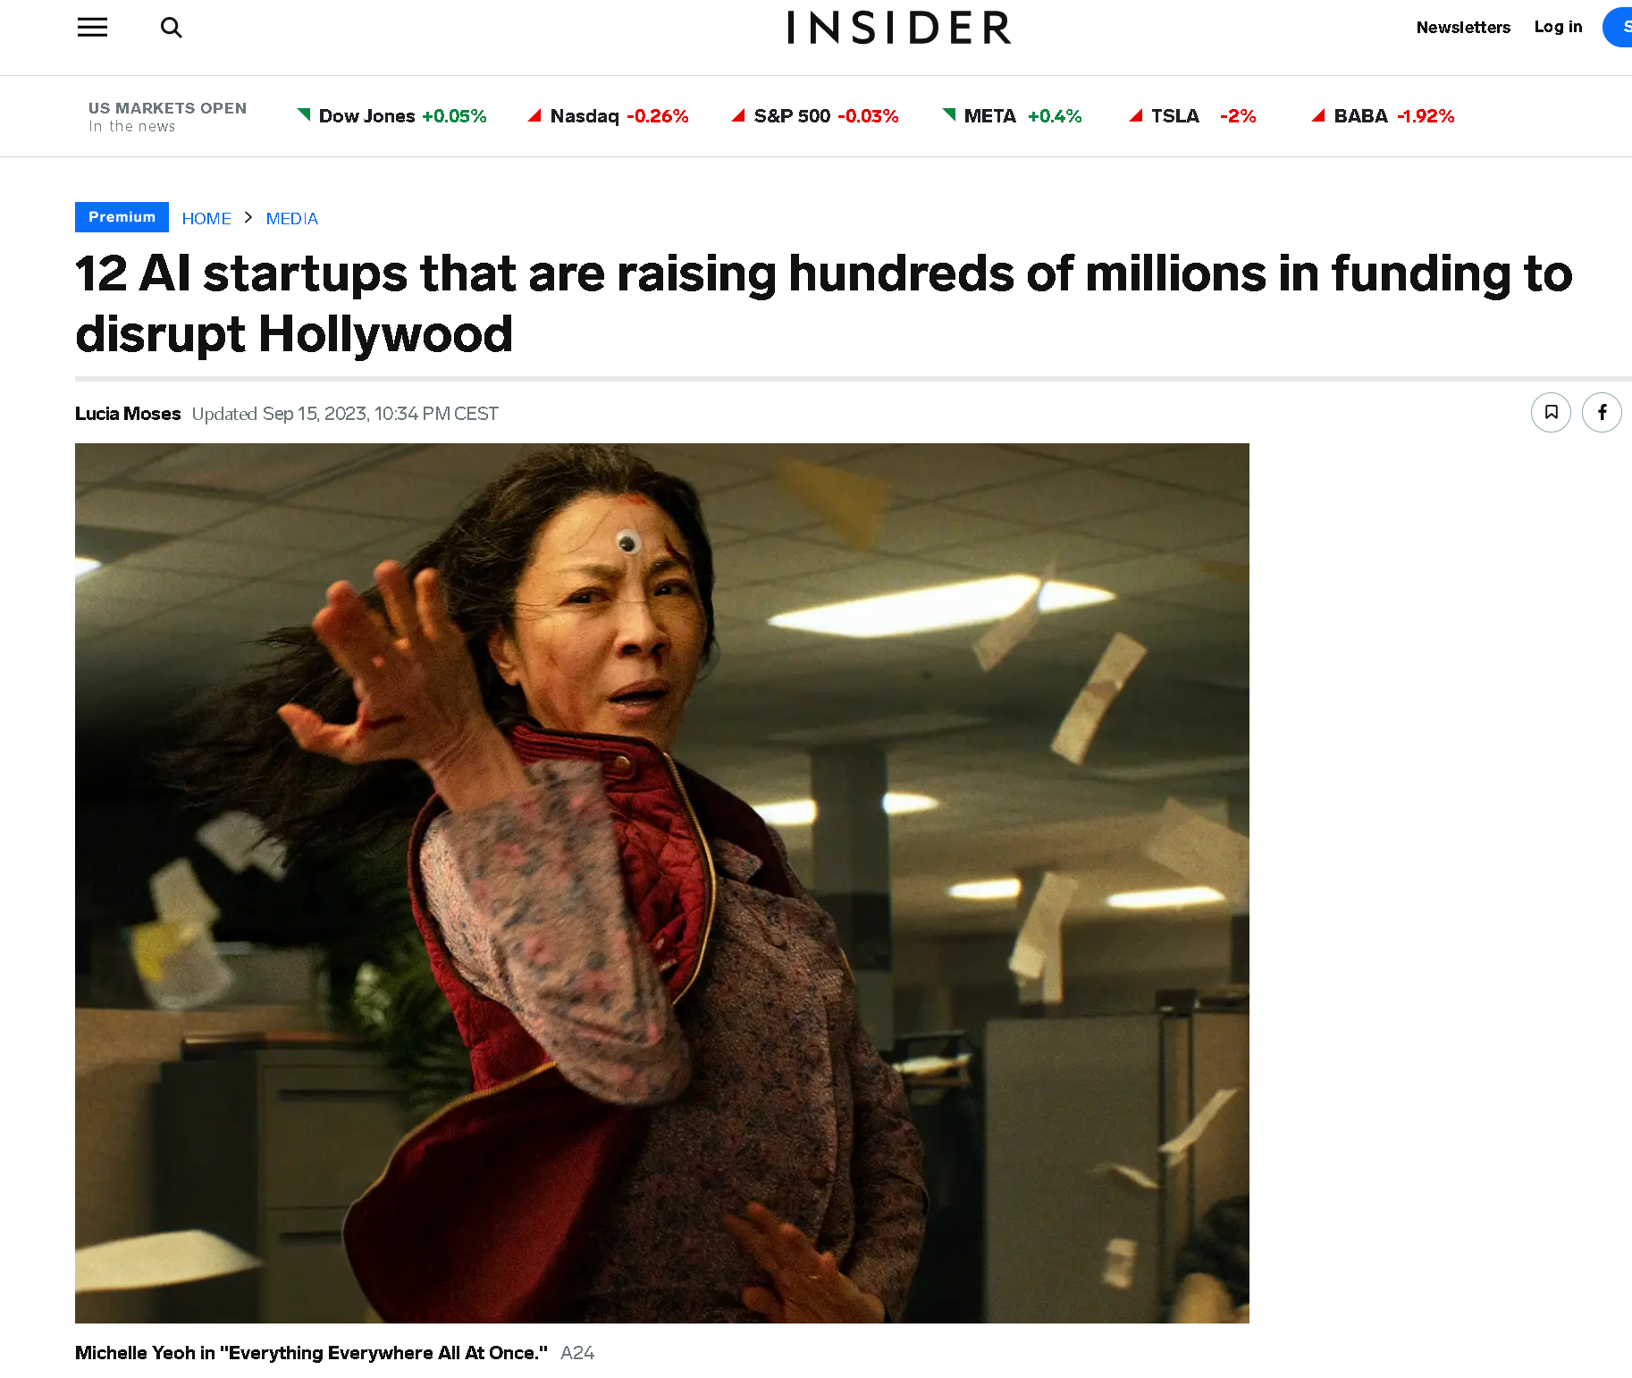
Deep Voodoo
DGene
ElevenLabs
MARZ
Papercup
Respeecher
Runaway
Strada
Wonder Dynamics Ready Player Me
Avatars.me
Vocaloids
UneeQ
https://www.businessinsider.com/ai-startups-netflix-marvel-lucasfilm-holllywood-deepfake-dubbing-vc-funding-2023-3?r=US&IR=T

Slide 7
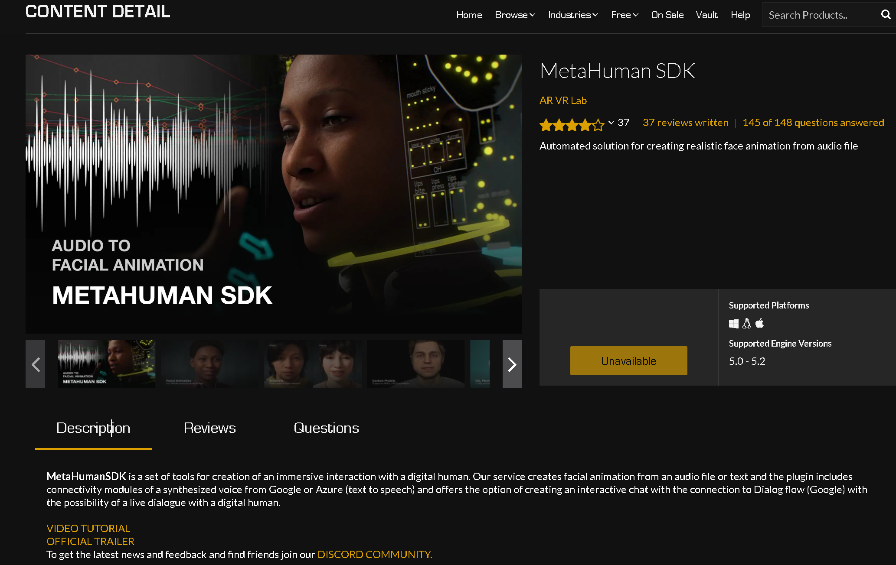
https://www.unrealengine.com/marketplace/en-US/item/66b869fa0d3748e78d422e59716597b6

Slide 8
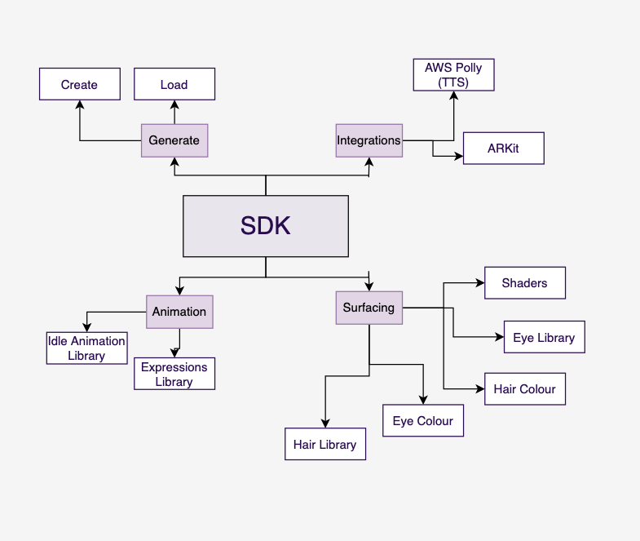


Slide 9
TALIGE IMPLEMENTATIE
Digital human

Slide 10
ChatGPT is een Conversationele
tekst-in/tekst-uit AI-agent
BLACK-BOX
Sánchez-Díaz, X., Ayala-Bastidas, G., Fonseca-Ortiz, P., & Garrido, L. (2018). A knowledge-based methodology for building a conversational chatbot as an intelligent tutor. https://doi.org/10.1007/978-3-030-04497-8_14

Slide 11
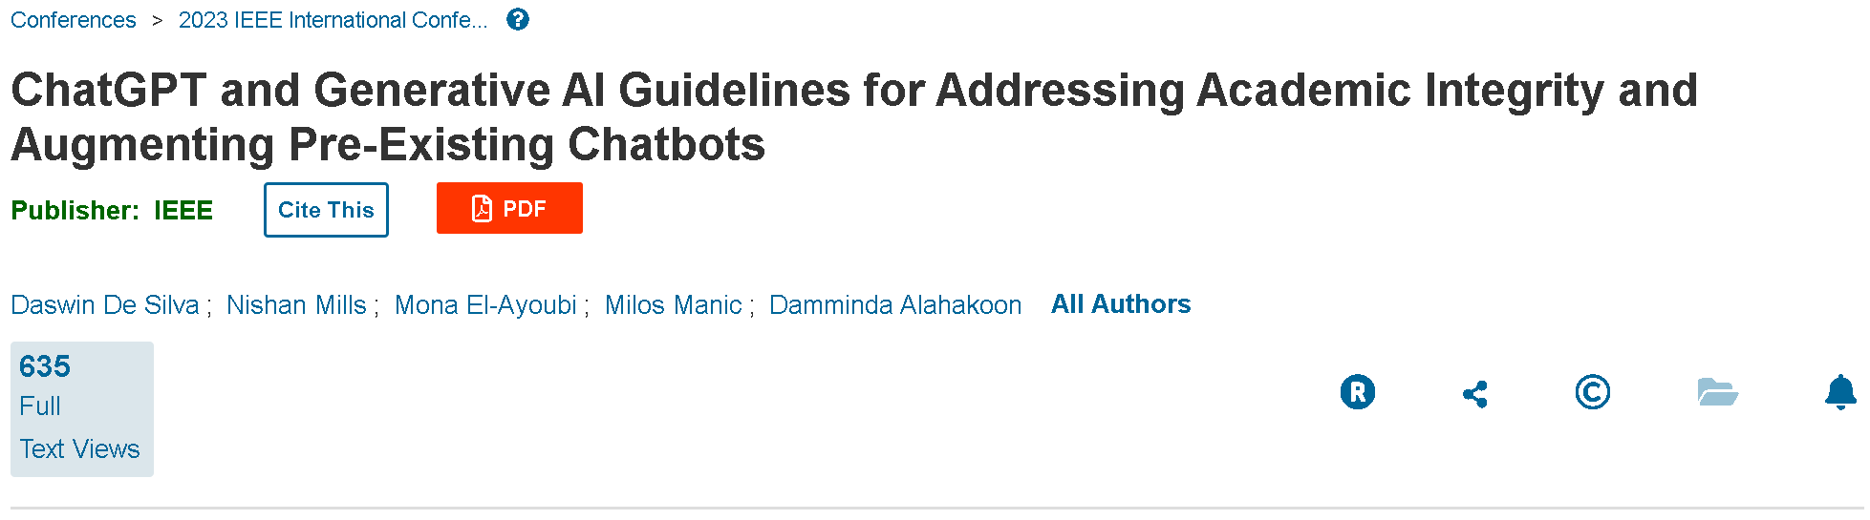
Conversational Agents

Slide 12
ROBOT IMPLEMENTATIE
Digital human

Slide 13
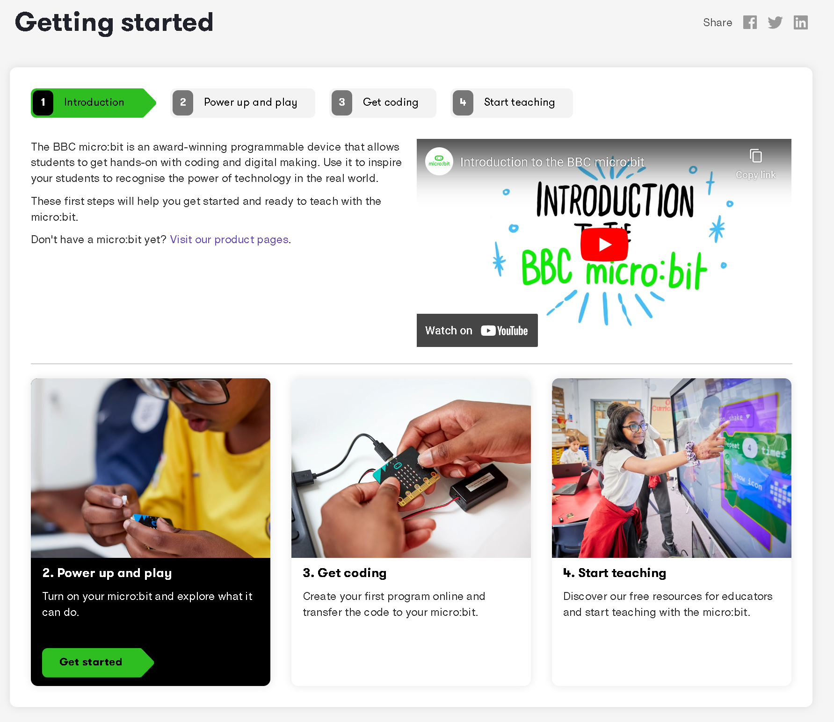

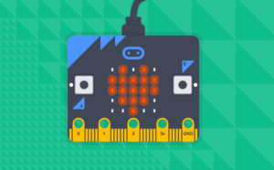
https://microbit.org/get-started/getting-started/introduction/

Slide 14
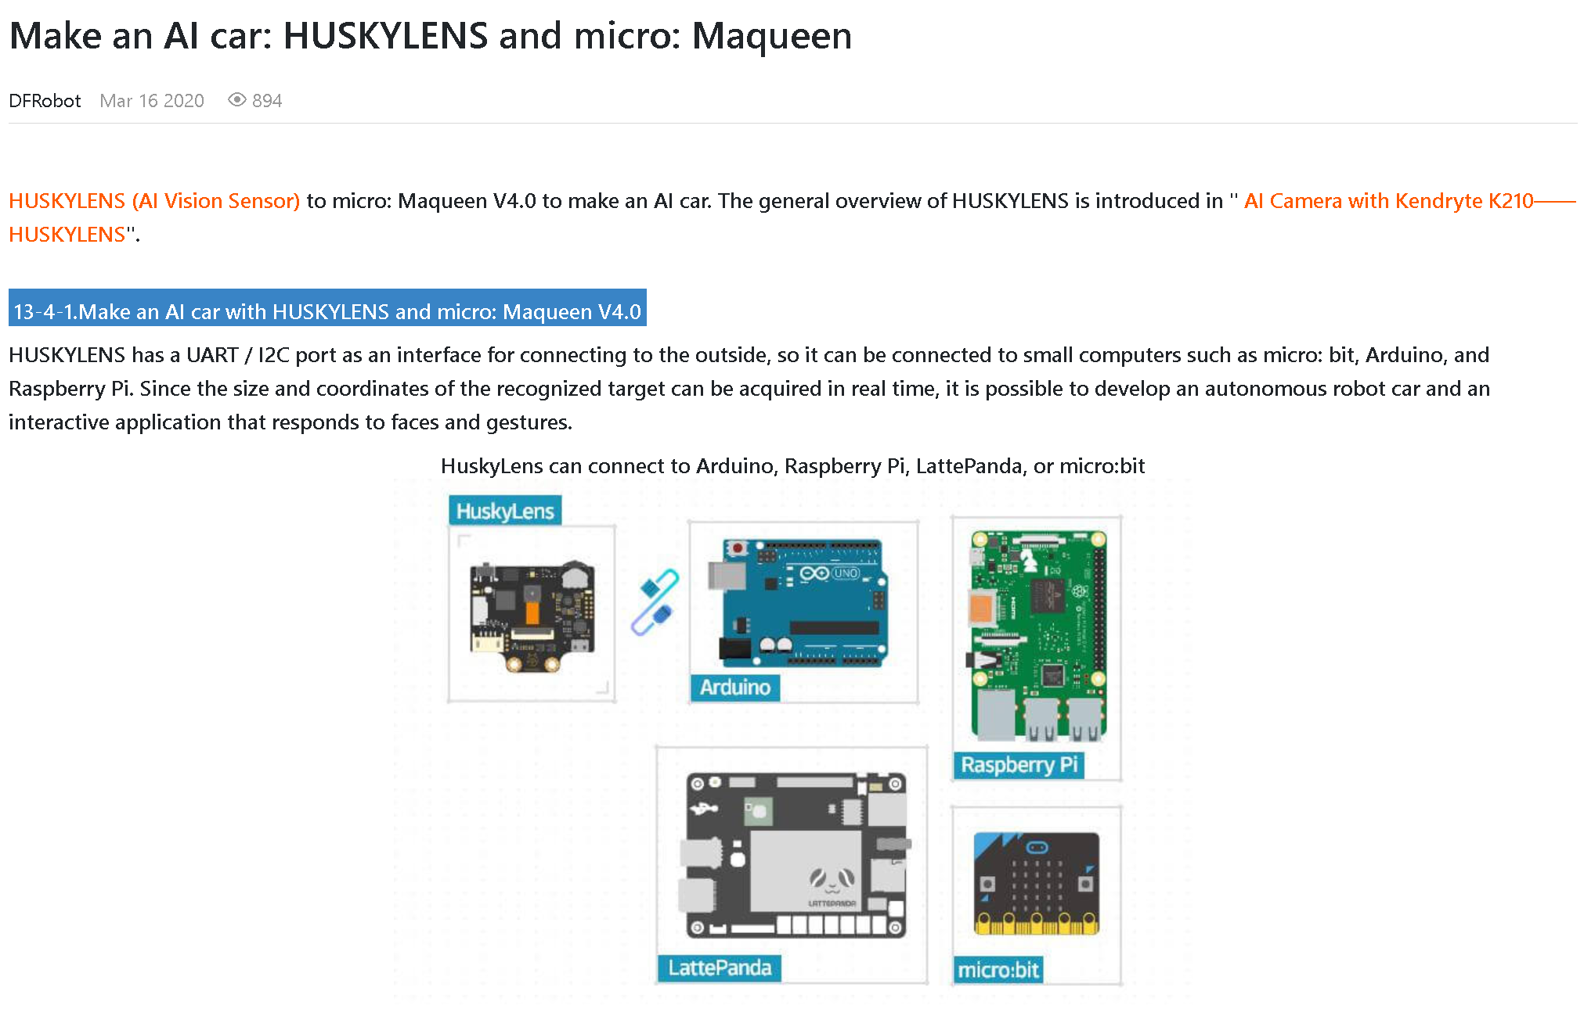
https://www.dfrobot.com/blog-1483.html

Slide 15
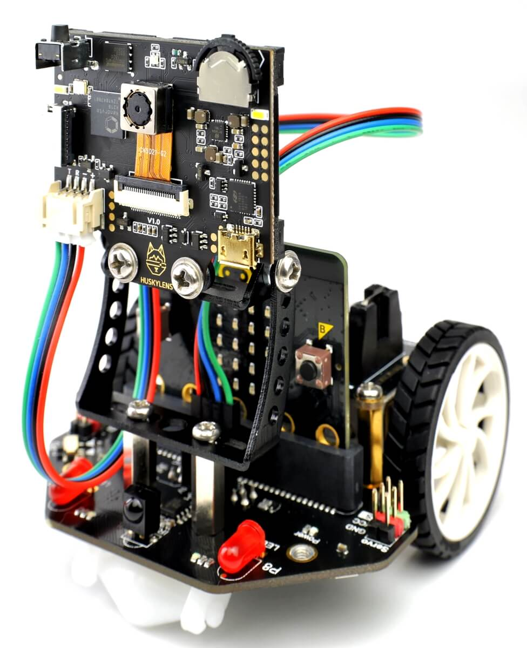
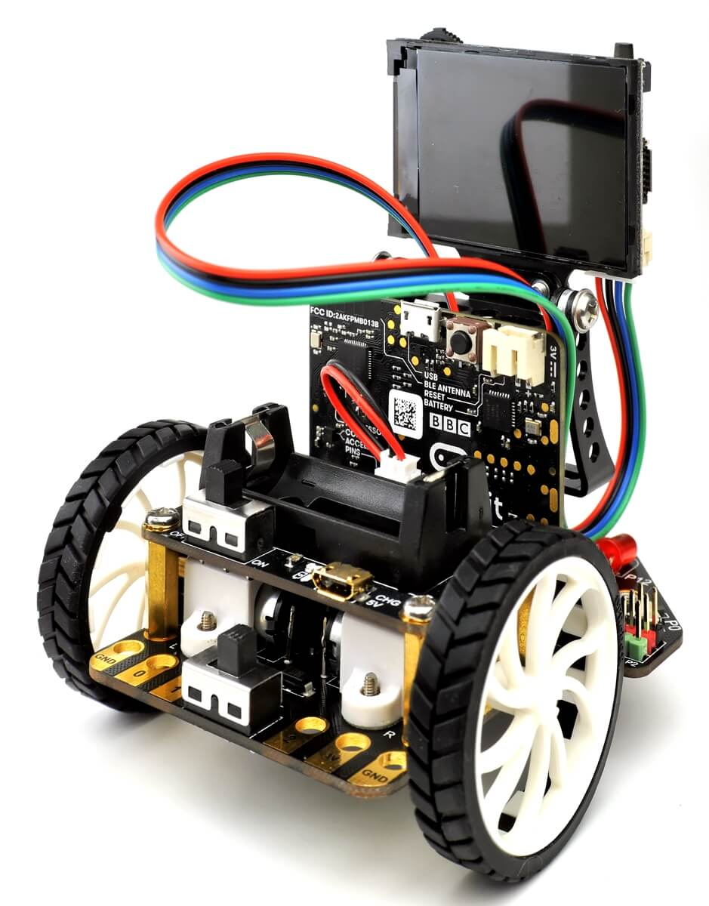
https://www.dfrobot.com/blog-1483.html

Slide 16
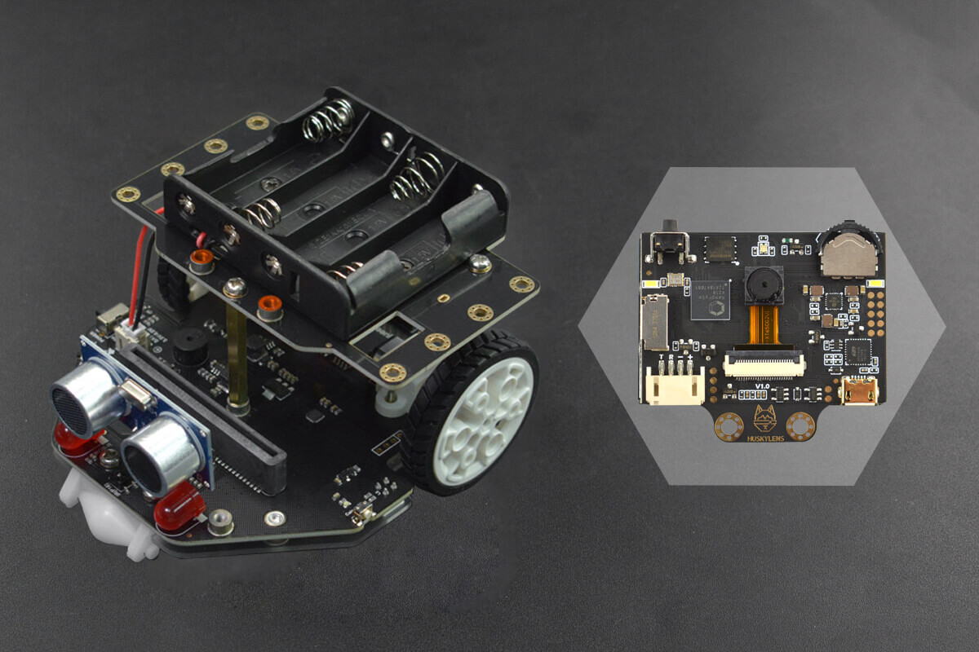
https://wiki.dfrobot.com/SKU_MBT0021-EN_Maqueen_Plus_STEAM_Programming_Educational_Robot

Slide 17
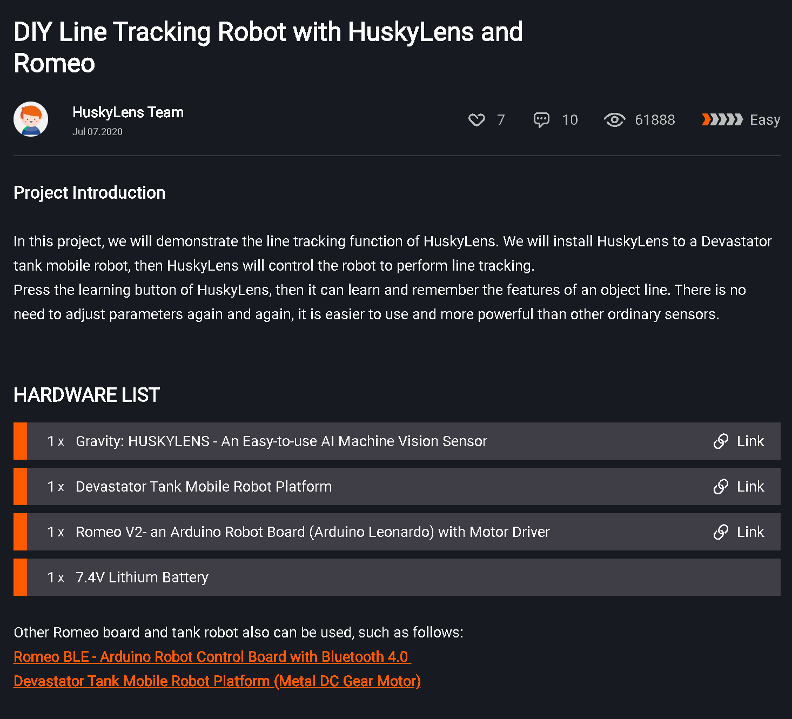
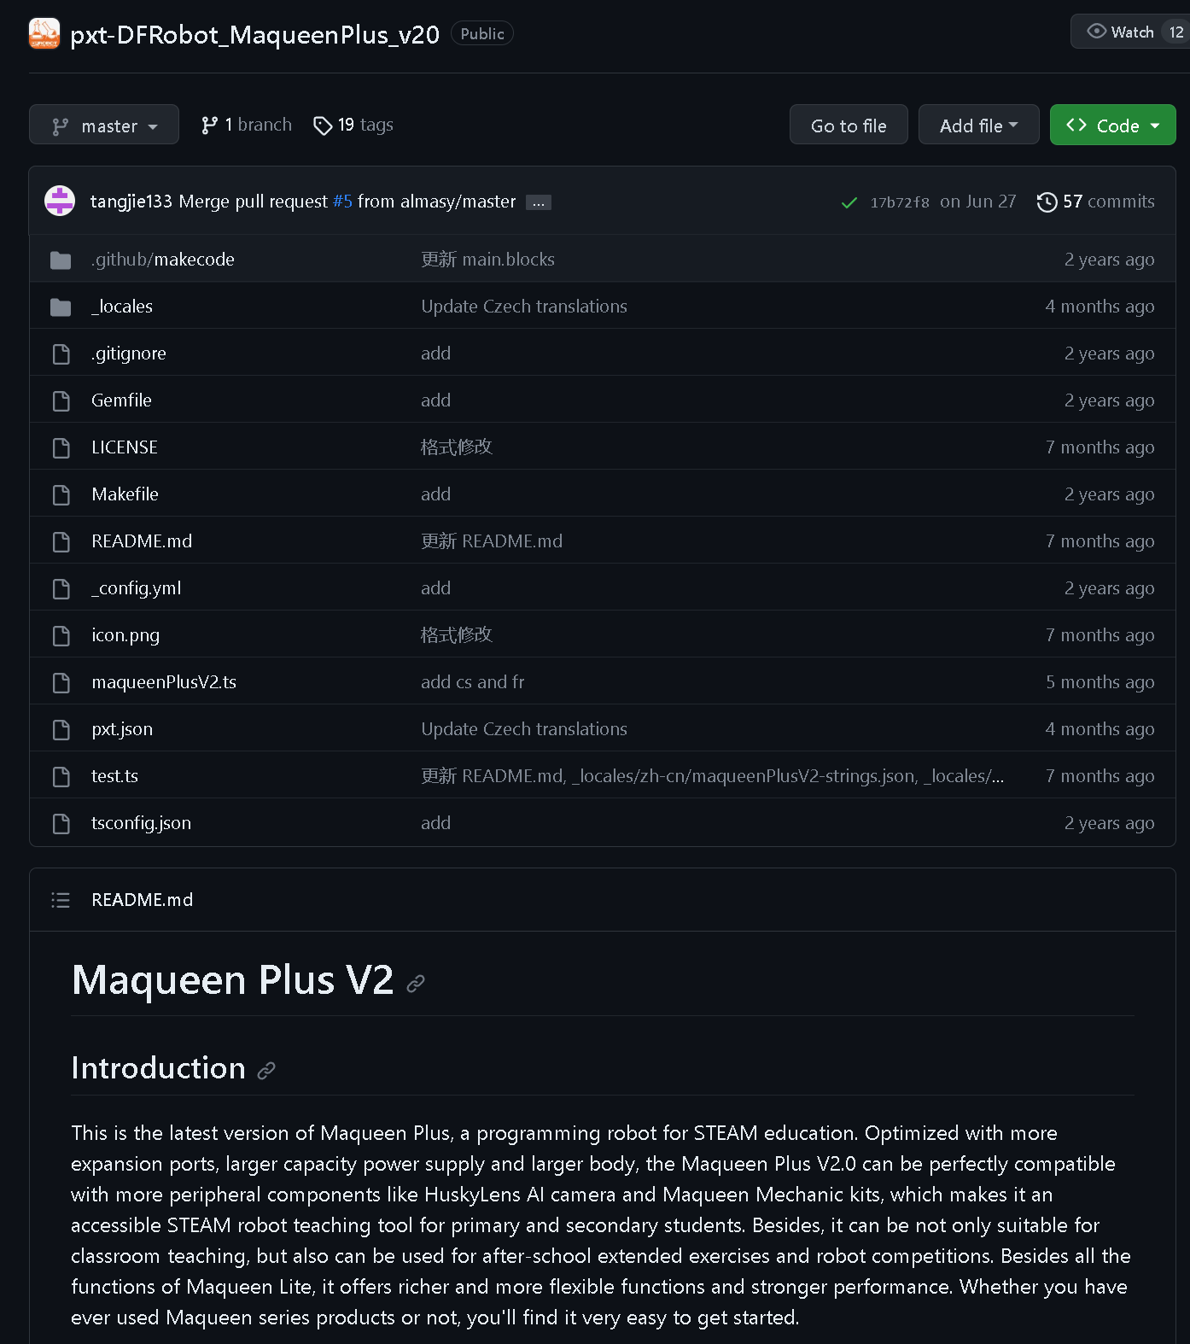
https://community.dfrobot.com/makelog-308279.html
https://github.com/DFRobot/pxt-DFRobot_MaqueenPlus_v20

Slide 18
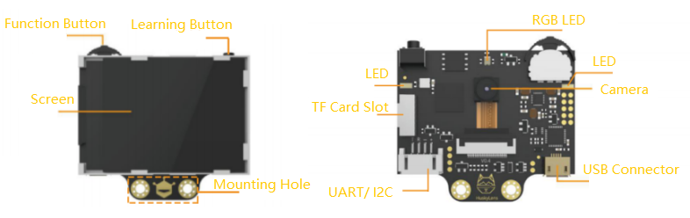

Slide 19
DIGTALE IMPLEMENTATIE
Digital human
VIDEO DUBBING

Slide 20
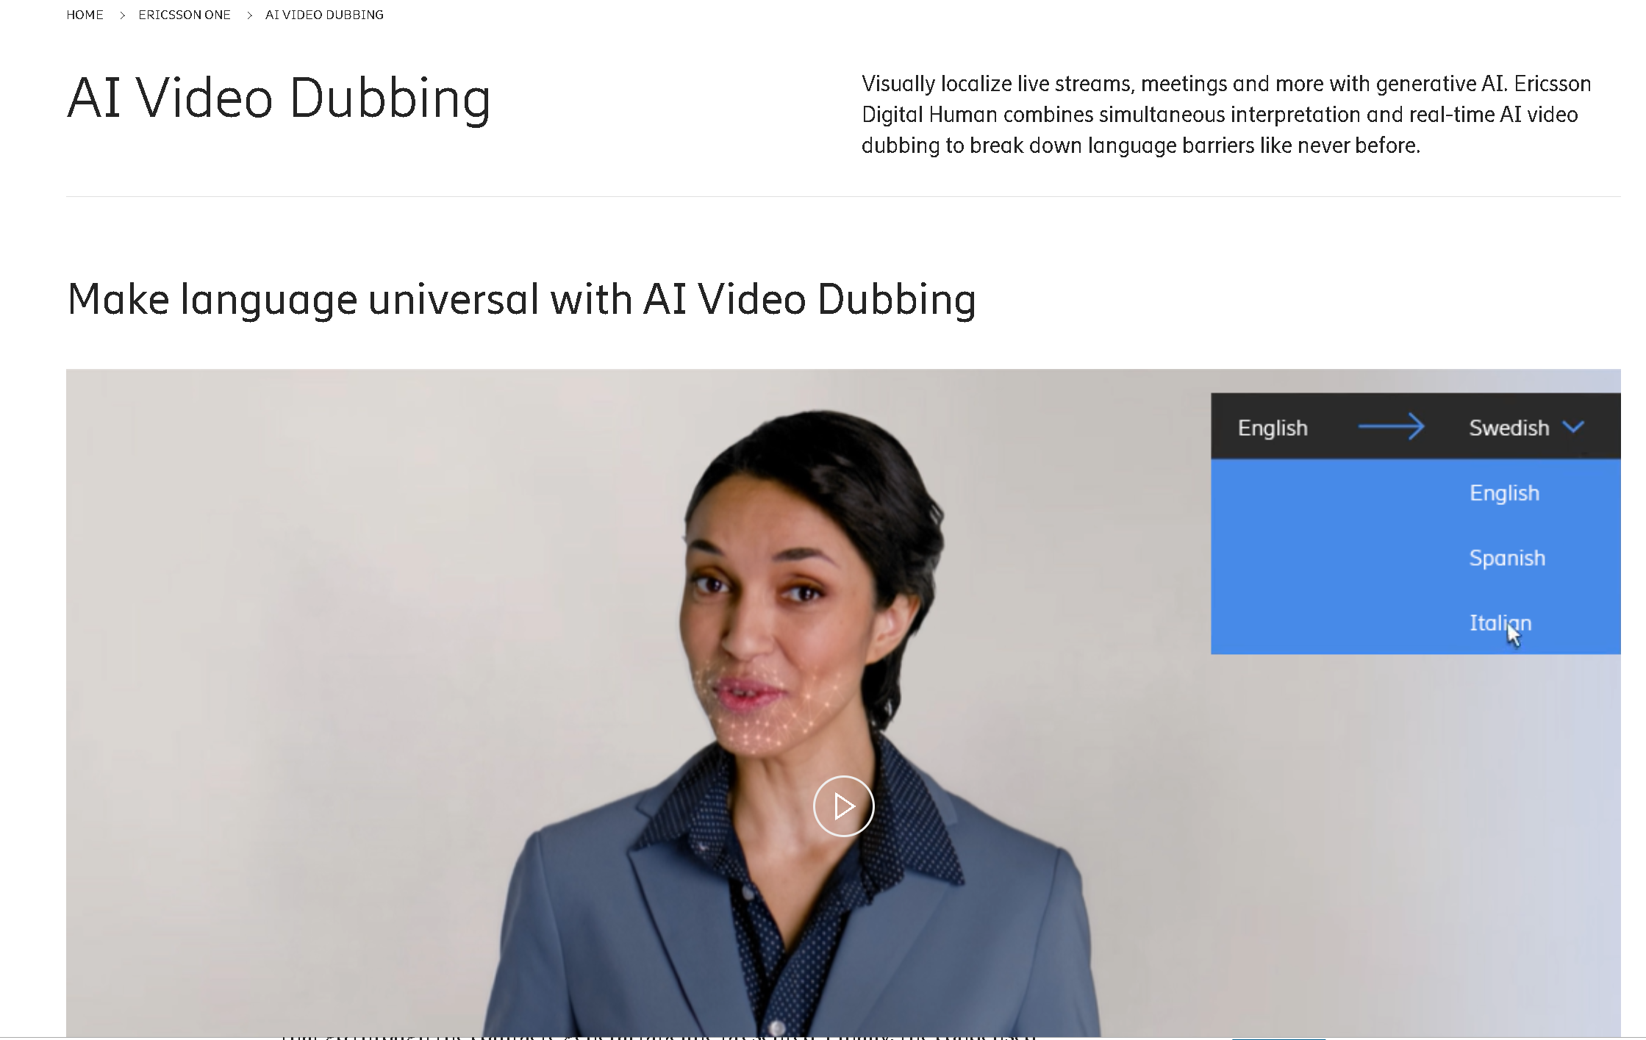
https://www.ericsson.com/en/ericsson-one/digitalhuman

Slide 21

https://www.tencentcloud.com/products/ivh

Slide 22
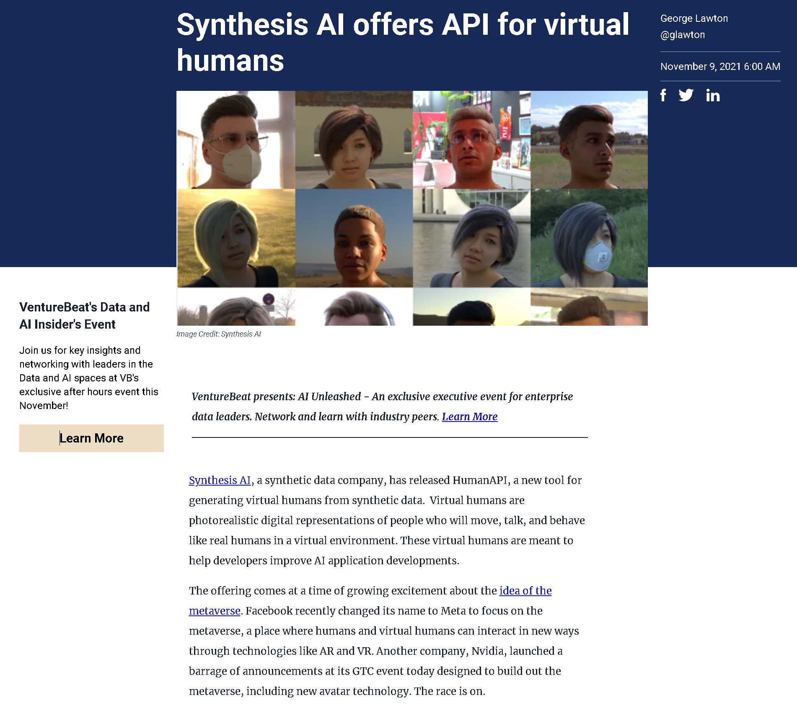
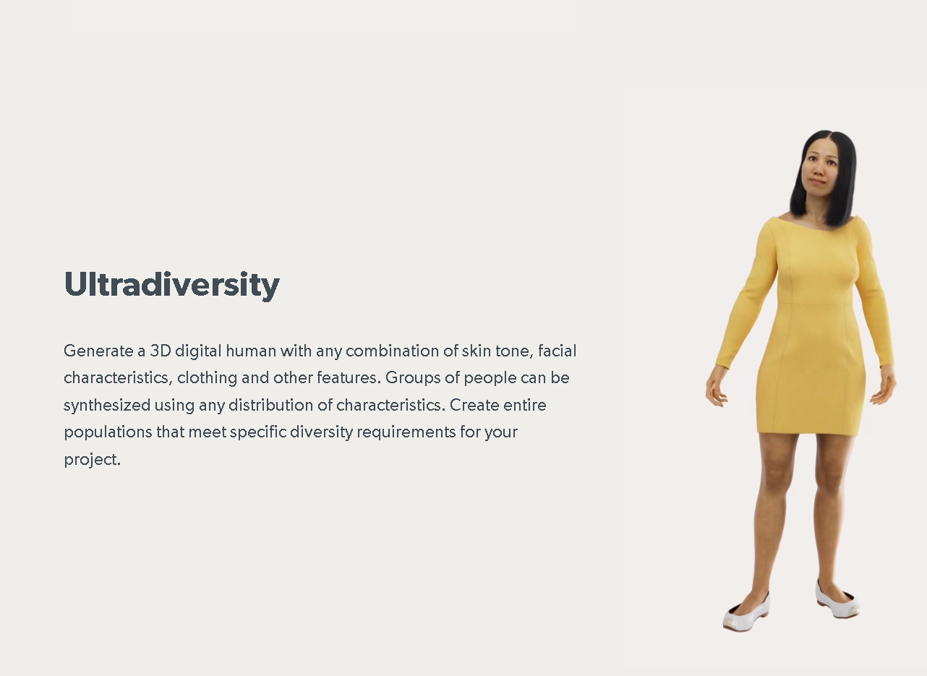
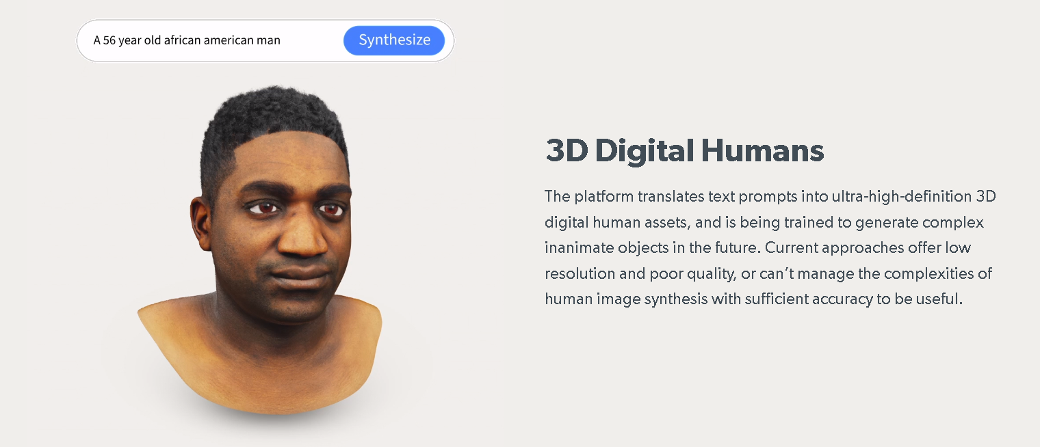
https://venturebeat.com/ai/synthetic-data-api-for-virtual-humans/

Slide 23
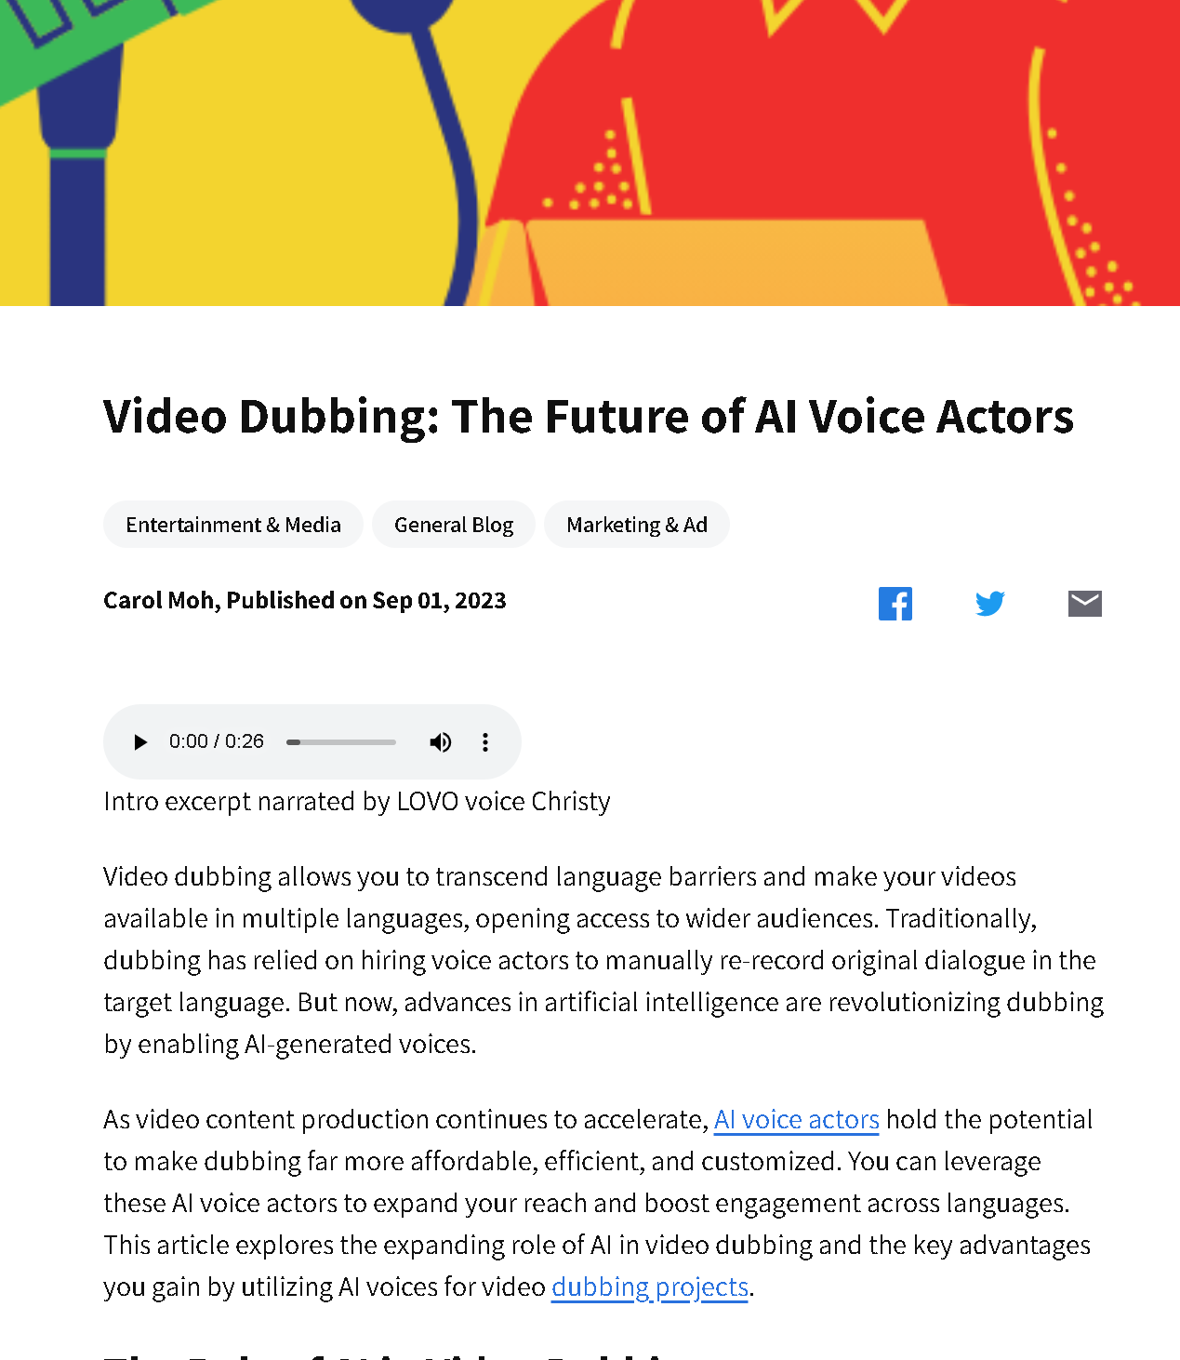
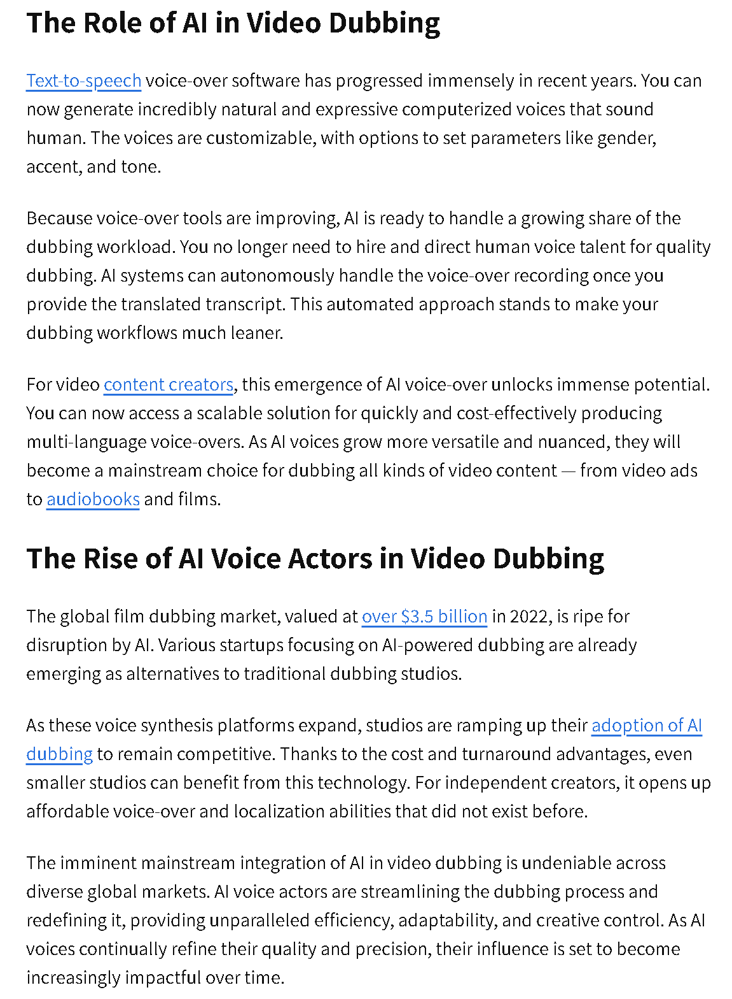
https://lovo.ai/post/video-dubbing-the-future-of-ai-voice-actors

Slide 24
DIGTALE IMPLEMENTATIE
Digital human
GAME ENGINE

Slide 25
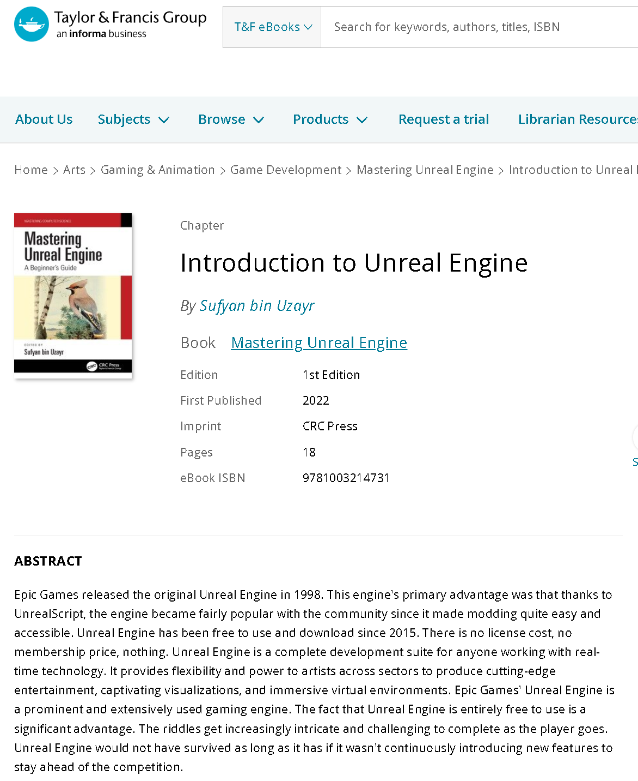

Slide 26
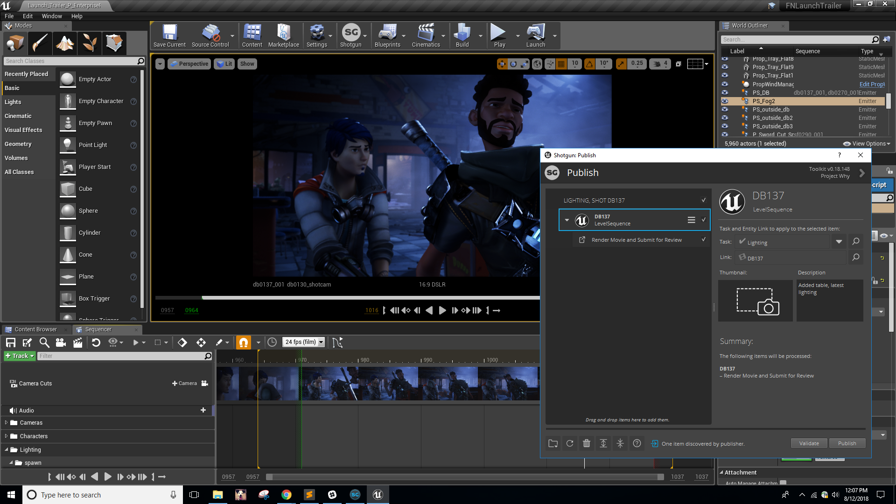
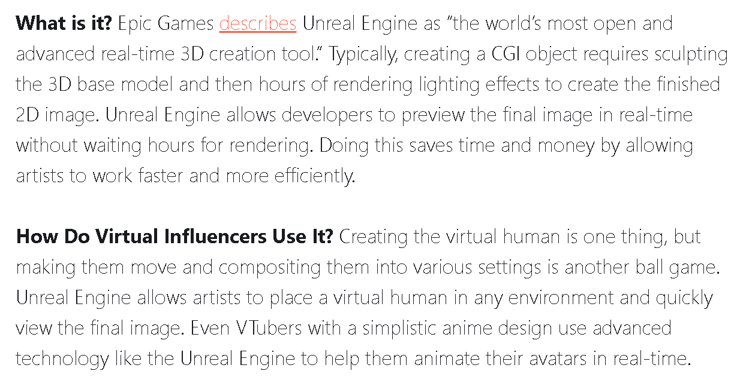
https://www.virtualhumans.org/article/the-video-game-engines-bringing-virtual-influencers-to-life

Slide 27
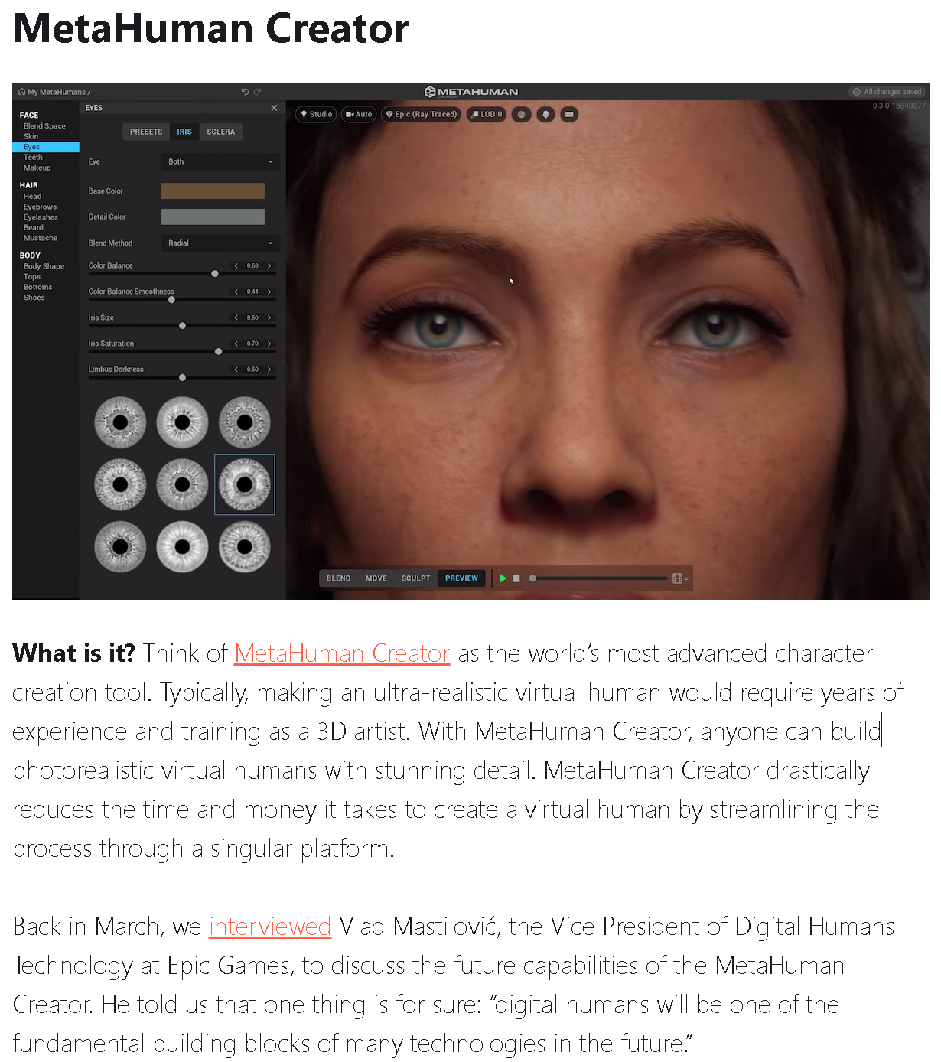

Slide 28
https://www.nvidia.com/en-us/on-demand/session/gtcspring21-s31882/

Slide 29
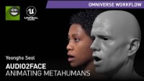
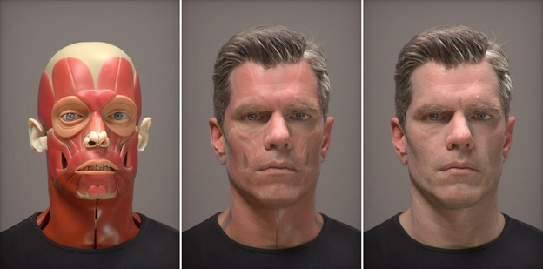
https://developer.nvidia.com/blog/an-era-of-digital-humans-pushing-the-envelope-of-photorealistic-digital-character-creation/

Slide 30
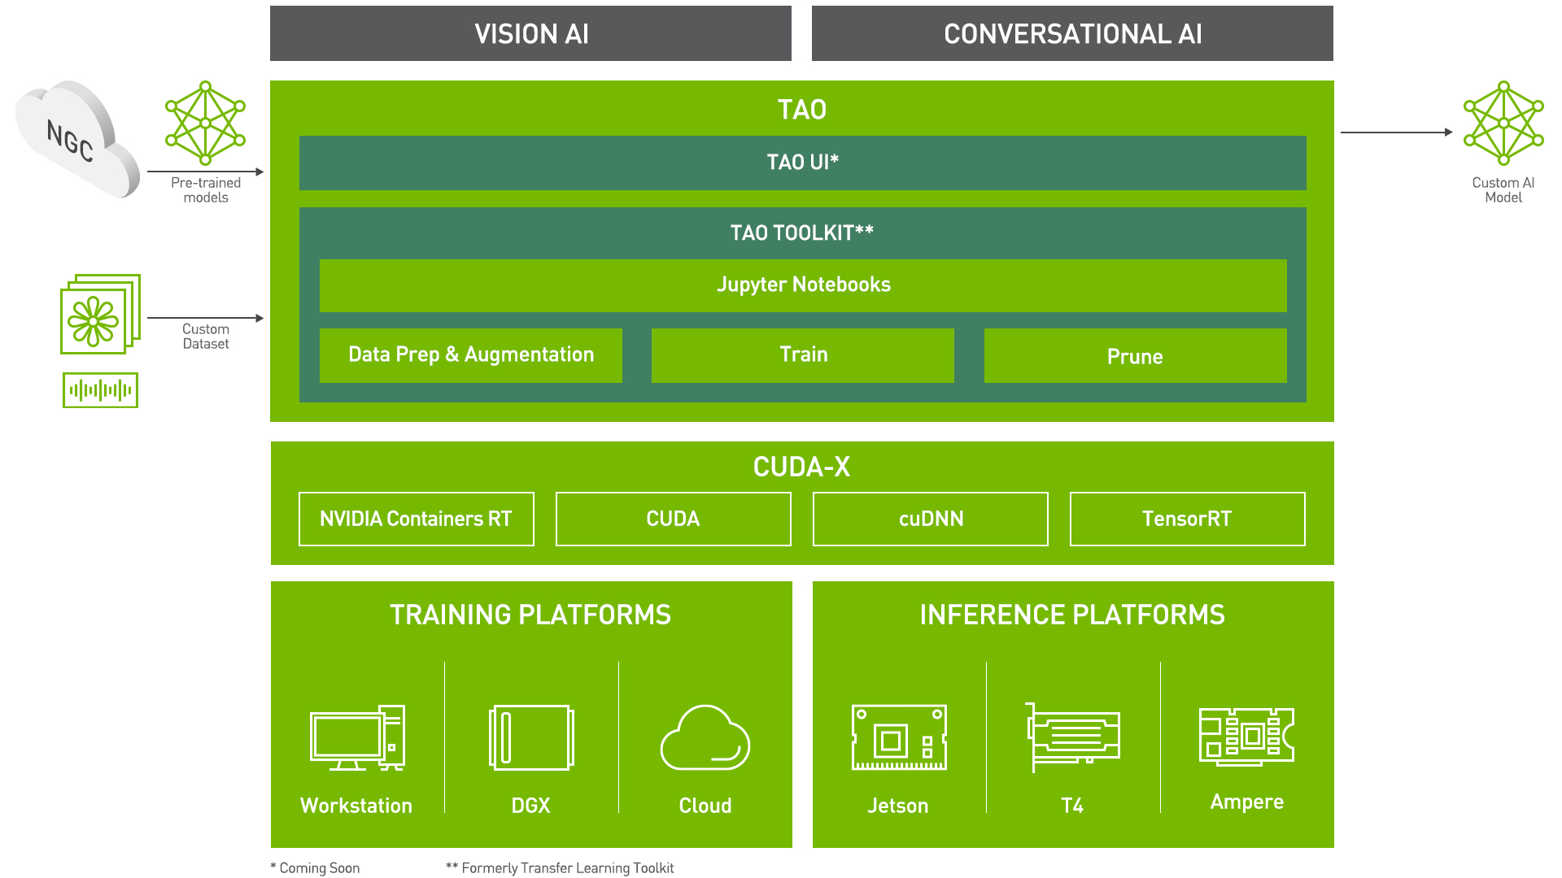
https://developer.nvidia.com/blog/fast-track-your-production-ai-with-pre-trained-models-and-tao-toolkit-3-0/

Slide 31
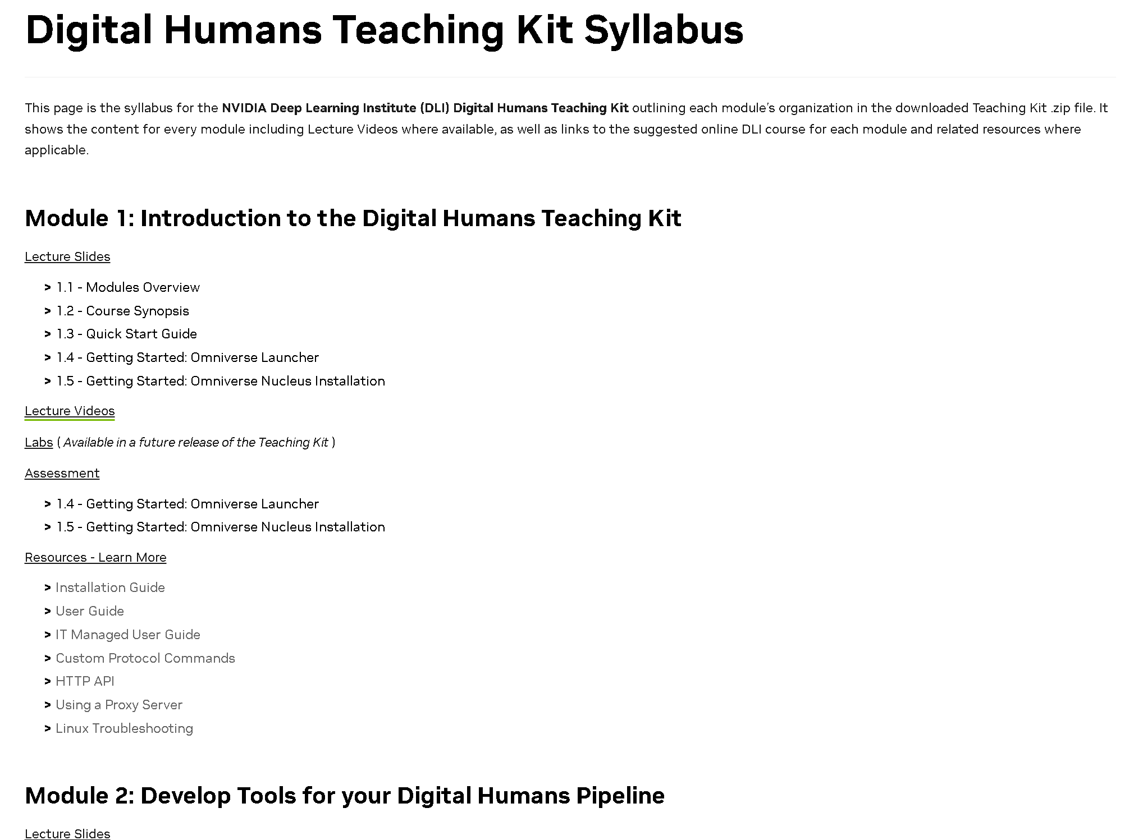
Digital Humans Teaching Kit Syllabus
https://developer.nvidia.com/digital-humans-teaching-kit-syllabus

Slide 32

https://www.digitalhumans.com/blog/uneeq-first-digital-human-sdk-ar-vr-experiences

Slide 33
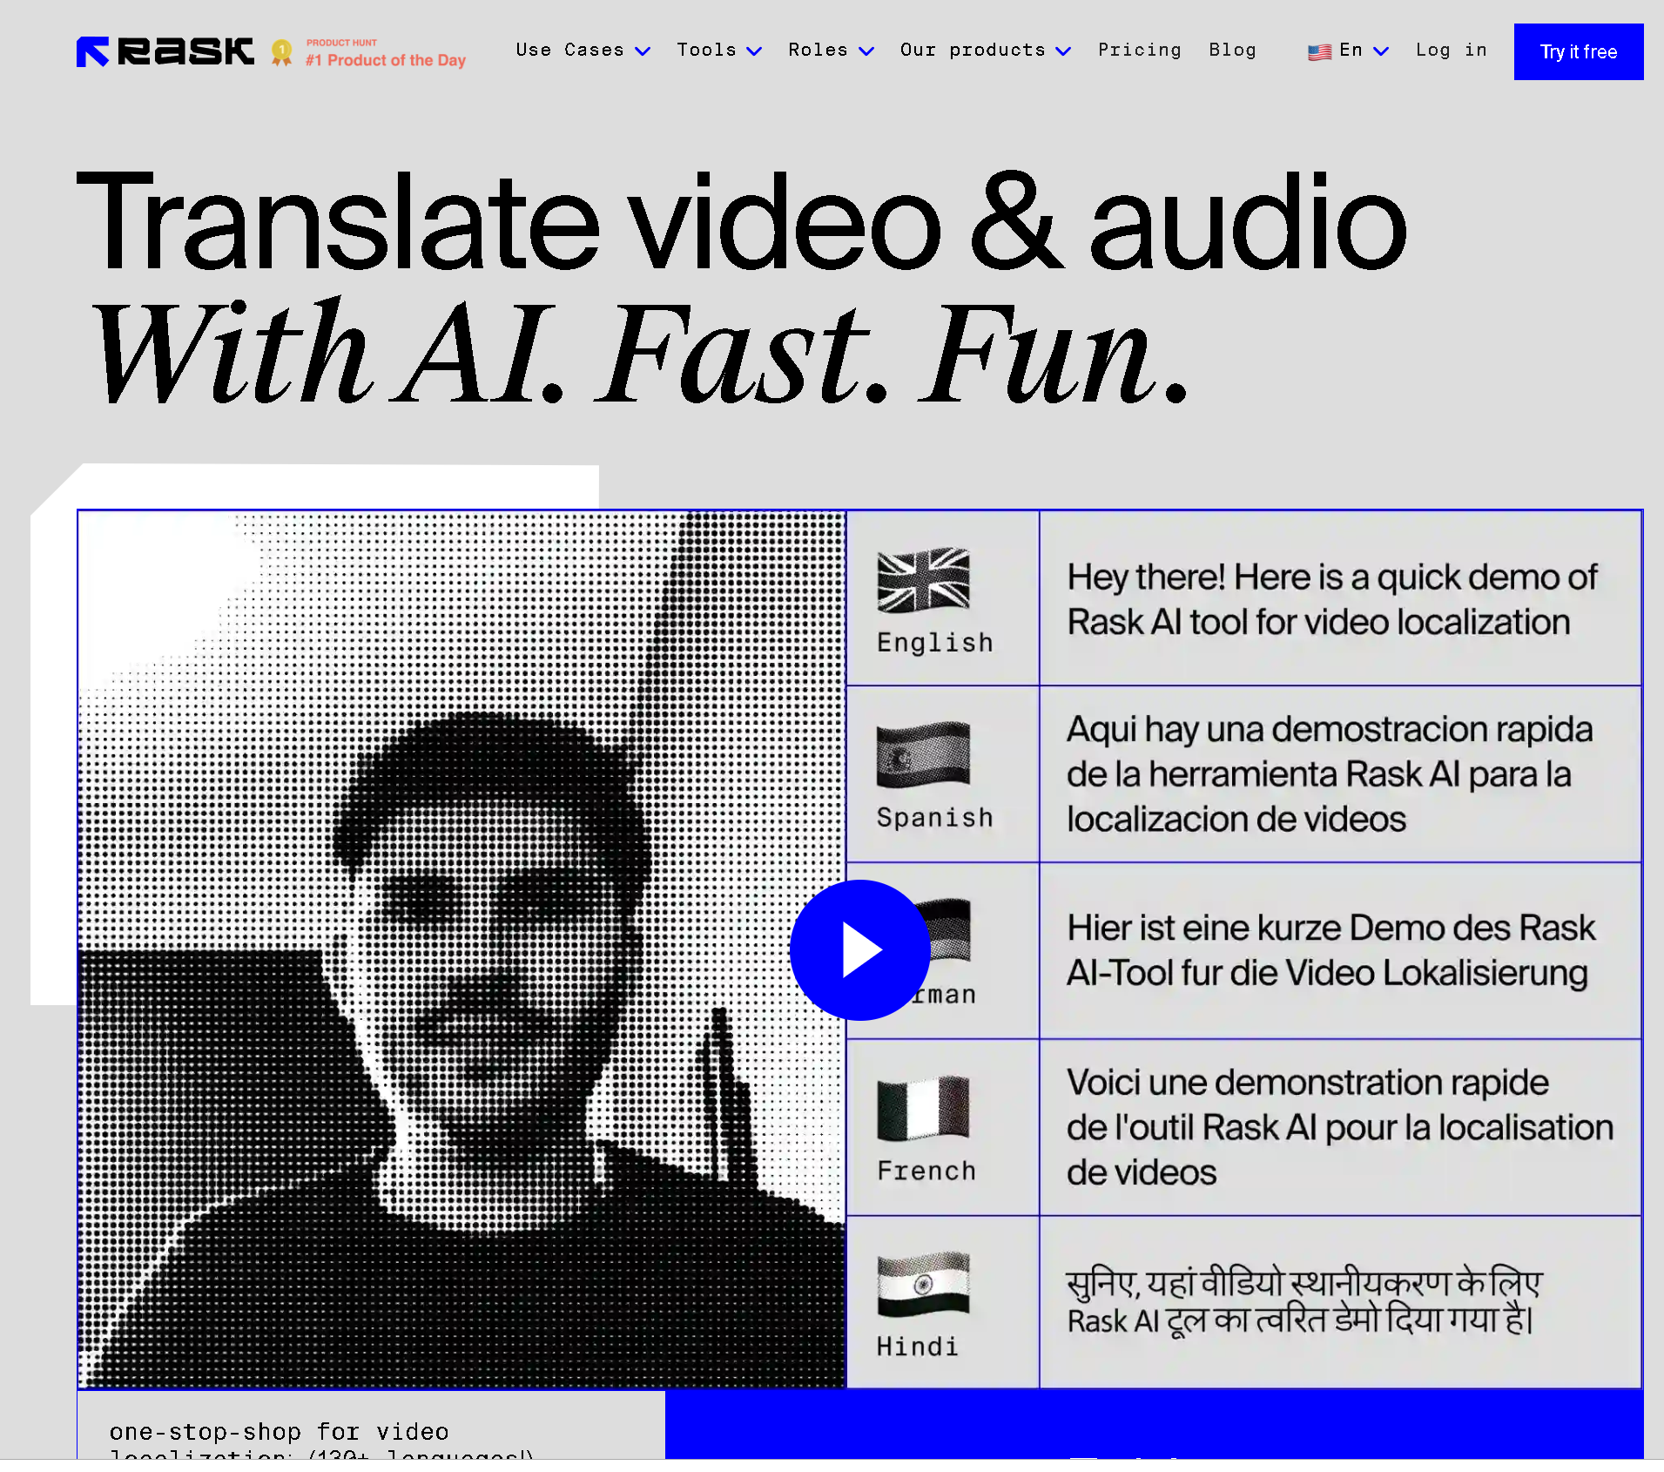
https://www.rask.ai/

Slide 34
Prompt engineering
DIY {do it yourself}

Slide 35
PROMPT
Een prompt is een natuurlijke taal instructie gericht aan een conversationele AI-agent met als doel om de werking ervan te verbeteren of te verfijnen.

Slide 36
Prompt Recept Structuur
Een prompt is opgebouwd uit de volgende elementen:
Instructie(s)
Context
Invoergegevens
Uitvoer-indicator
Classificeer de onderstaande tekst als neuraal, negatief of positief
Text: Ik vond het eten wel zozo.
Sentiment:

Slide 37
I posted a
directive prompt to BARD
Explain to a non-native coding bachelor student how Unreal Engine could be used to build a "digital influencer" for a novel game.
Provide a table with al the necessary components and steps to be able to eventually launch de "digital human"
using Unreal-Engine to develop it.

Slide 38


I posted a
directive prompt to BARD/ChatGPT
Explain to a non-native coding bachelor student how Unreal Engine could be used to build a "digital influencer" for a novel game.
Provide a table with all the necessary components and steps to be able to eventually launch de "digital human"
using Unreal-Engine to develop it.

Slide 39
How to Build a Digital Influencer in Unreal Engine for a Novel Game
For a non-native coding bachelor student:
Unreal Engine is a powerful game engine that can be used to create a variety of different types of games and experiences, including digital influencers. Digital influencers are computer-generated characters that are designed to look and act like real people. They can be used to promote products, brands, or even their own ideas.
To build a digital influencer in Unreal Engine, you will need to:
Create a 3D character. This can be done using a variety of different 3D modeling software packages. Once you have created your character, you will need to export it to a format that is compatible with Unreal Engine.
Import your character into Unreal Engine. Once your character is imported into Unreal Engine, you will need to create a skeleton and rig it to your character. This will allow you to animate your character.
Create animations for your character.
You can use a variety of different methods to create animations for your character, including motion capture, procedural animation, and hand-keyframing.
Create a personality for your character.
What are your character's interests? What do they like and dislike? How do they interact with the world around them?
Once you have a good understanding of your character's personality, you can start to write scripts for them.
Create content for your digital influencer.
This could include videos, blog posts, social media posts, or even live streams. The content that you create should be tailored to your target audience and should reflect your character's personality.

Slide 40
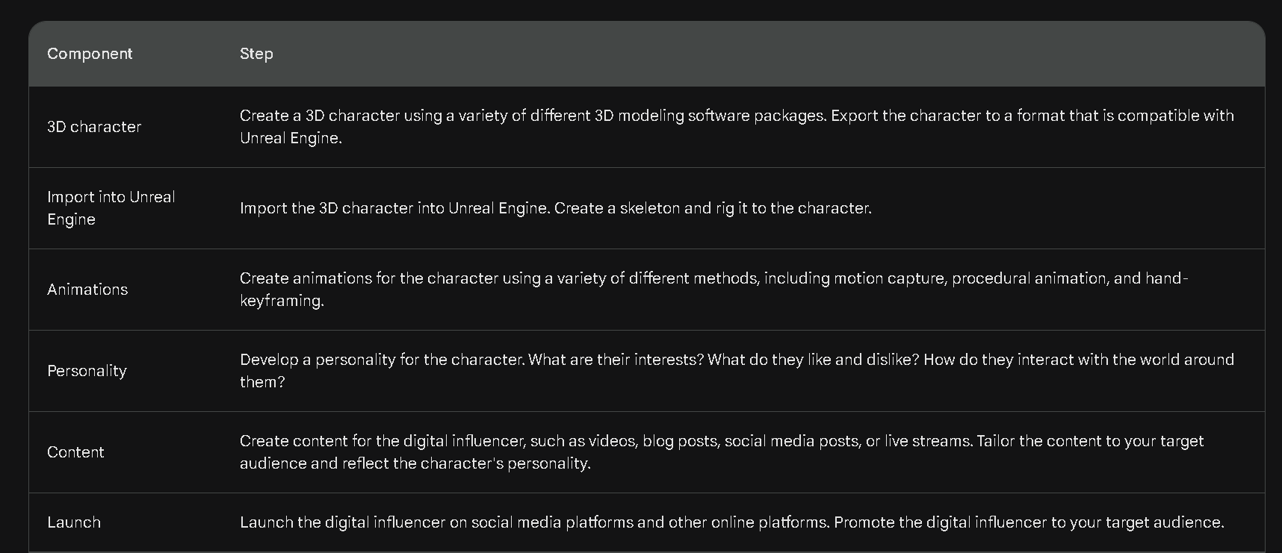

Slide 41
Additional notes:
It is important to note that building a digital influencer is a complex process that requires a variety of skills, including 3D modelling, animation, and storytelling.
It is also important to have a good understanding of Unreal Engine.
If you are a non-native coding bachelor student, it is important to start by learning the basics of Unreal Engine.
There are a variety of tutorials and resources available online.
Once you have a good understanding of Unreal Engine, you can start to learn more about the specific skills that are required to build a digital influencer.
There are also a variety of tutorials and resources available online for these skills.
It is also important to find a community of people who are working on similar projects.
There are a number of online forums and communities where you can connect with other people who are building digital influencers.

Slide 42
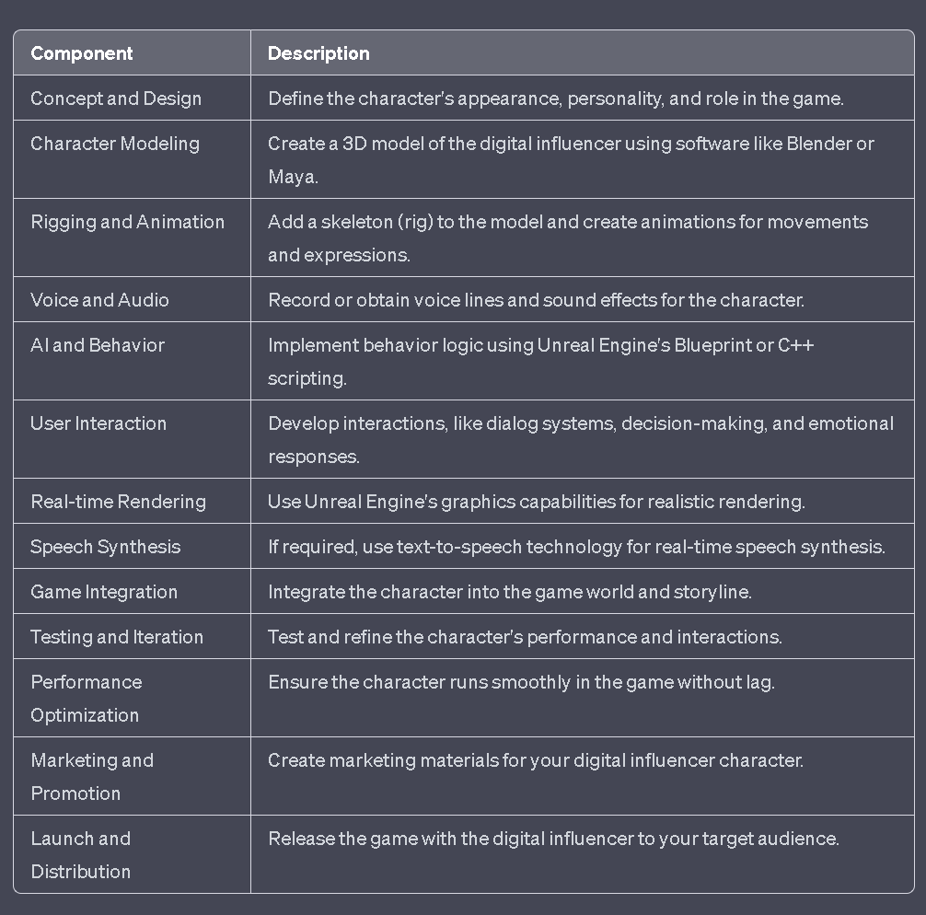

Slide 44
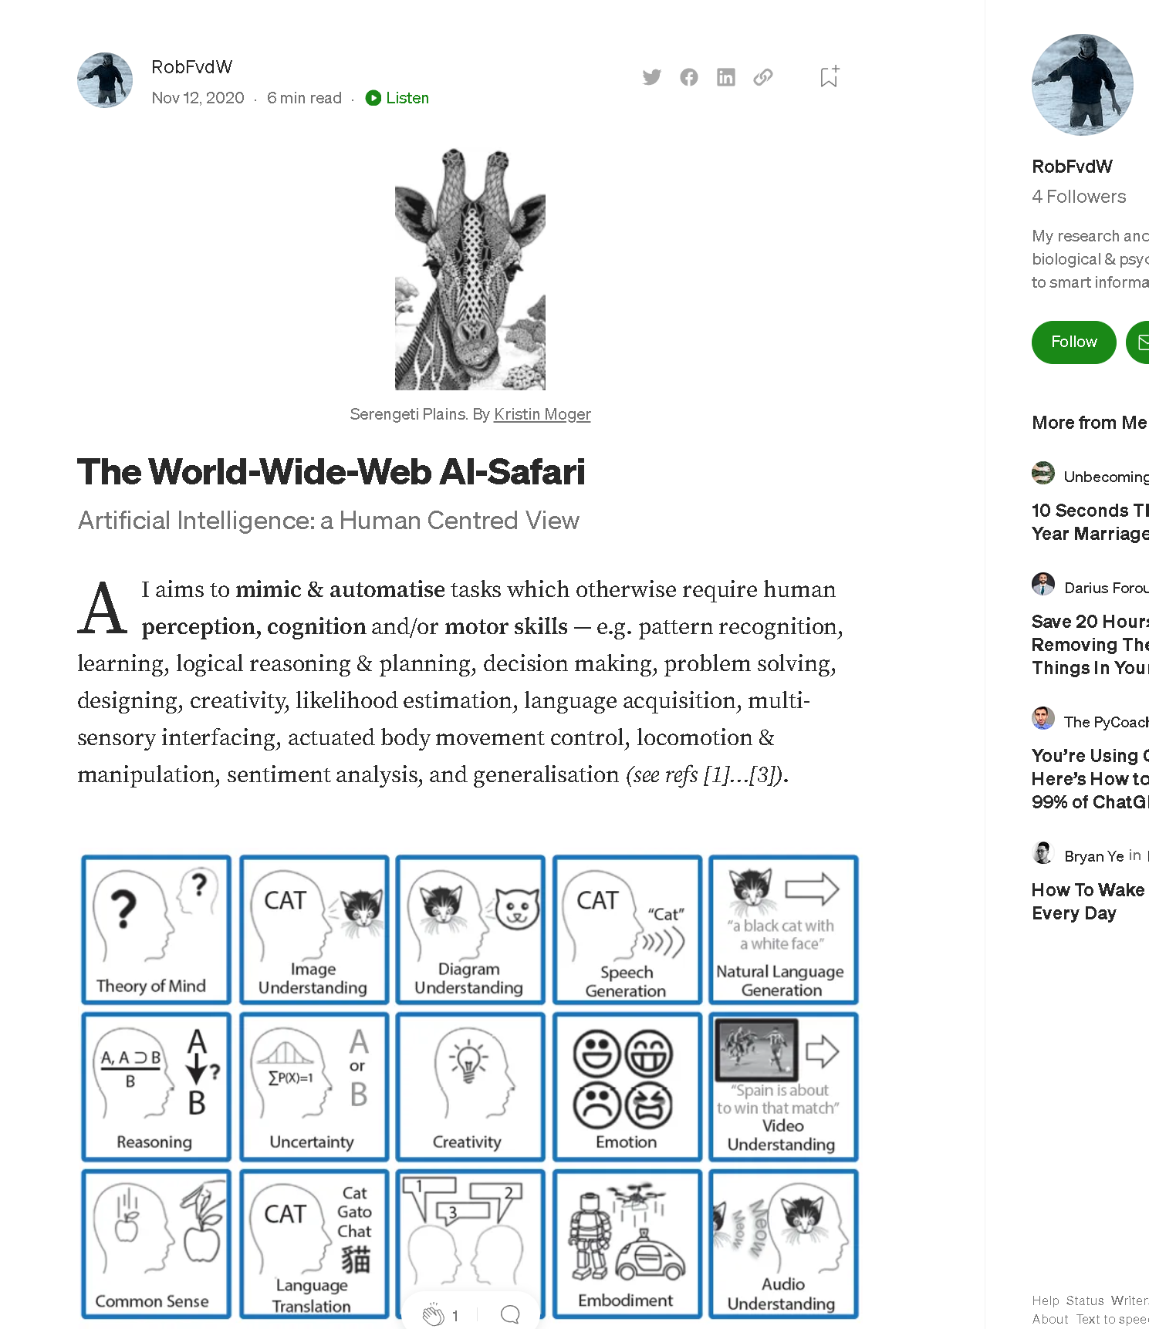


Who AM I?

Slide 45
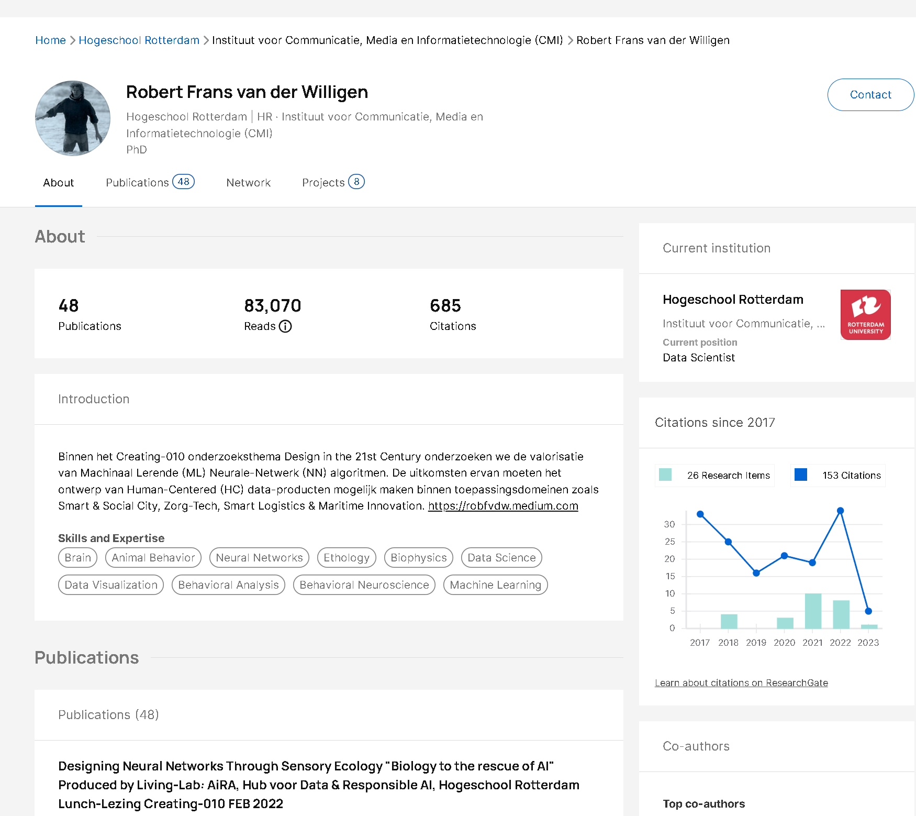

Who AM I?

Slide 46
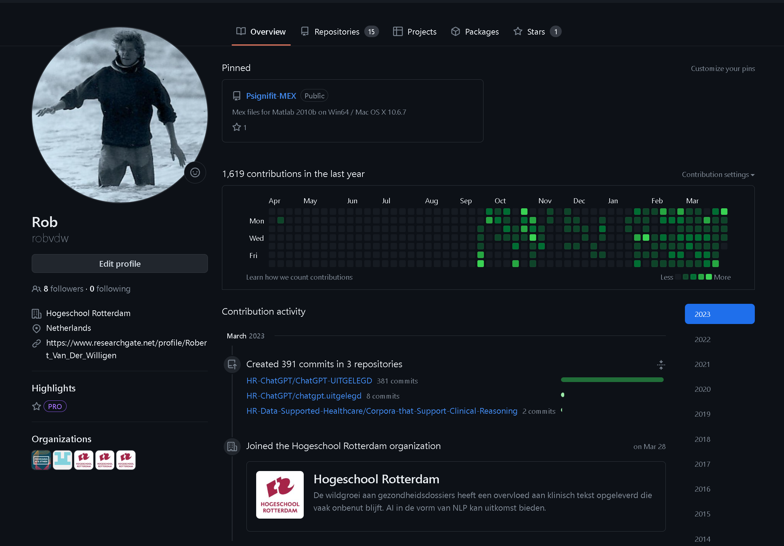

Who AM I?

